Slide 1
z/OS DevOps Traceability Reporting For Compliance, Diagnostics and Status
Nelson Lopez
Z DevOps Acceleration Team
Nelson.lopez1@ibm.com

Slide 2
Enriched reporting with
IBM Z DevOps tooling
The following illustrates End-to-End traceability starting from:
Code changes in Git
to DBB build report
into an artifact repository
and ending with deployment
Git – Source changes
DBB Build
Artifact Store
Deployment
who?
what?
when?
how?

Slide 3
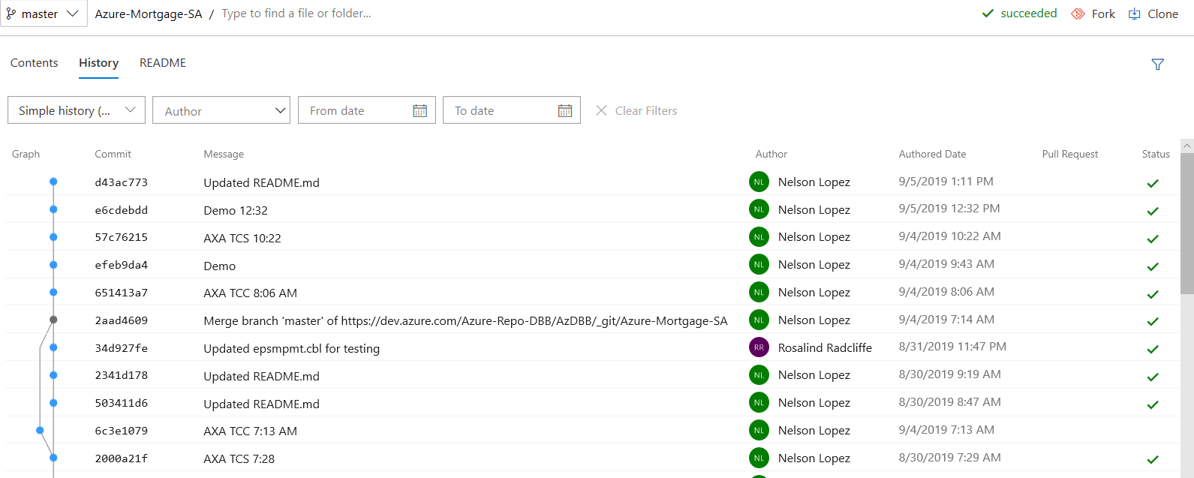
Trace changes to Git source files using
Hash ID (a commit point)
Git – Source changes

Slide 4
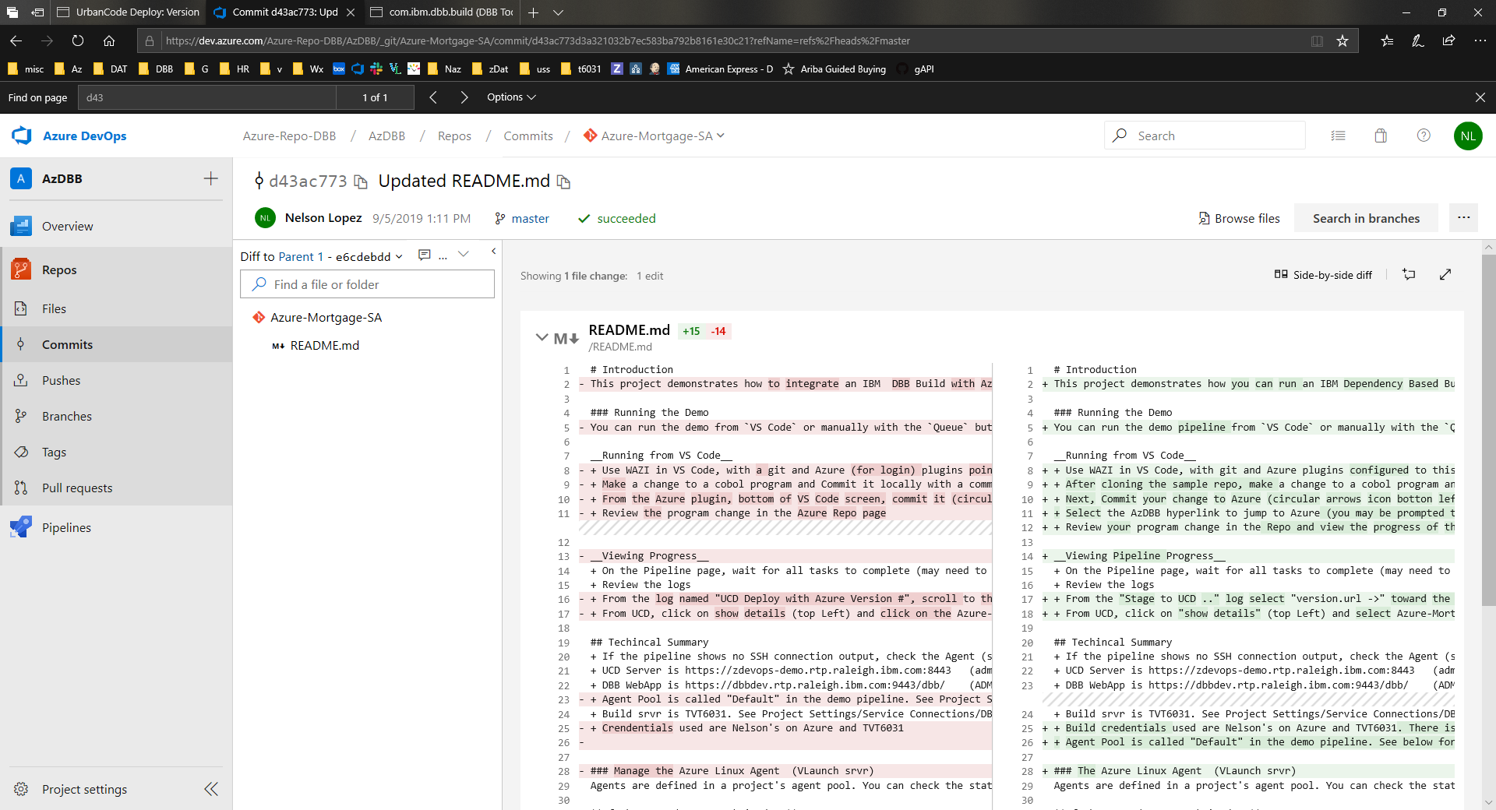
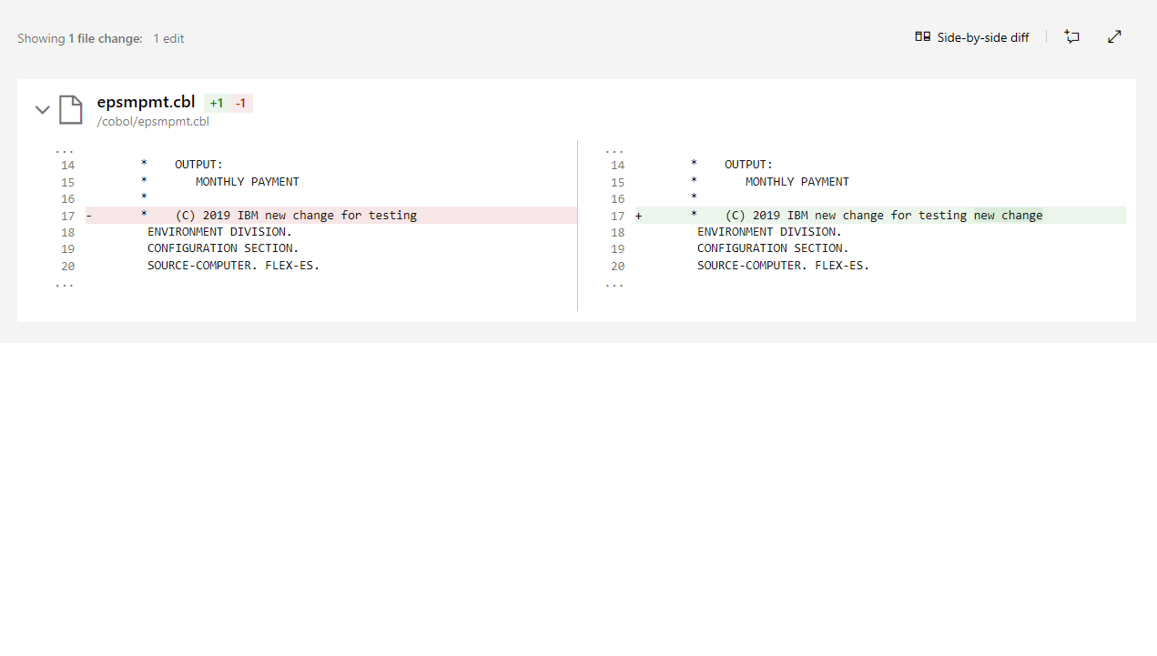
View change details
Git – Source changes

Slide 5
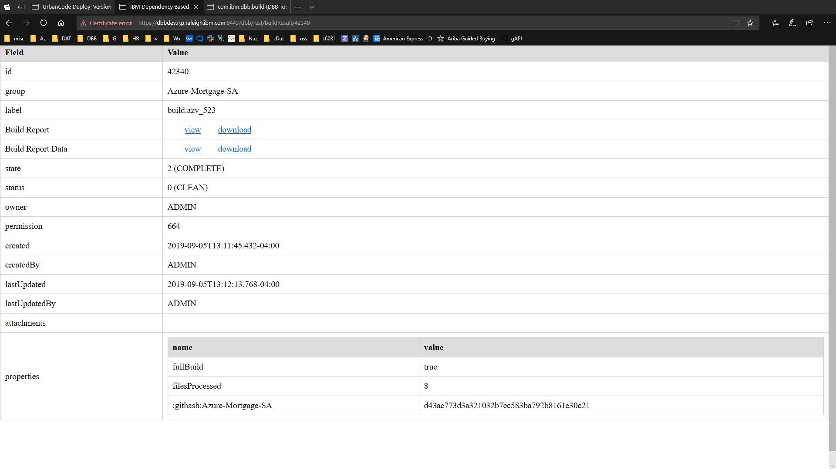
Git changes are linked to
DBB Builds with the Hash ID
DBB Build

Slide 6
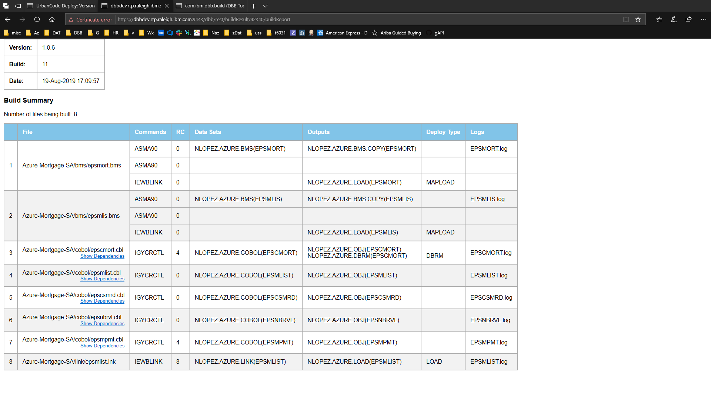
View details of the DBB Build
DBB Build

Slide 7
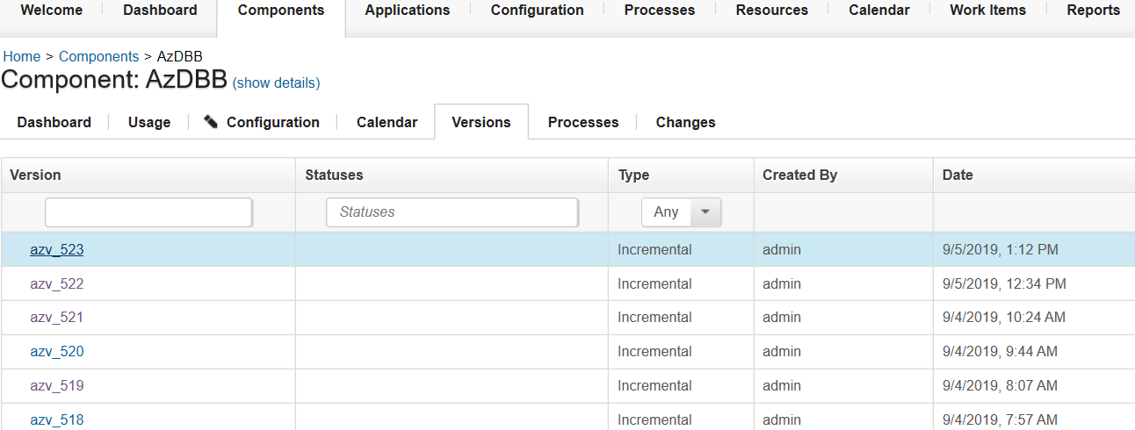
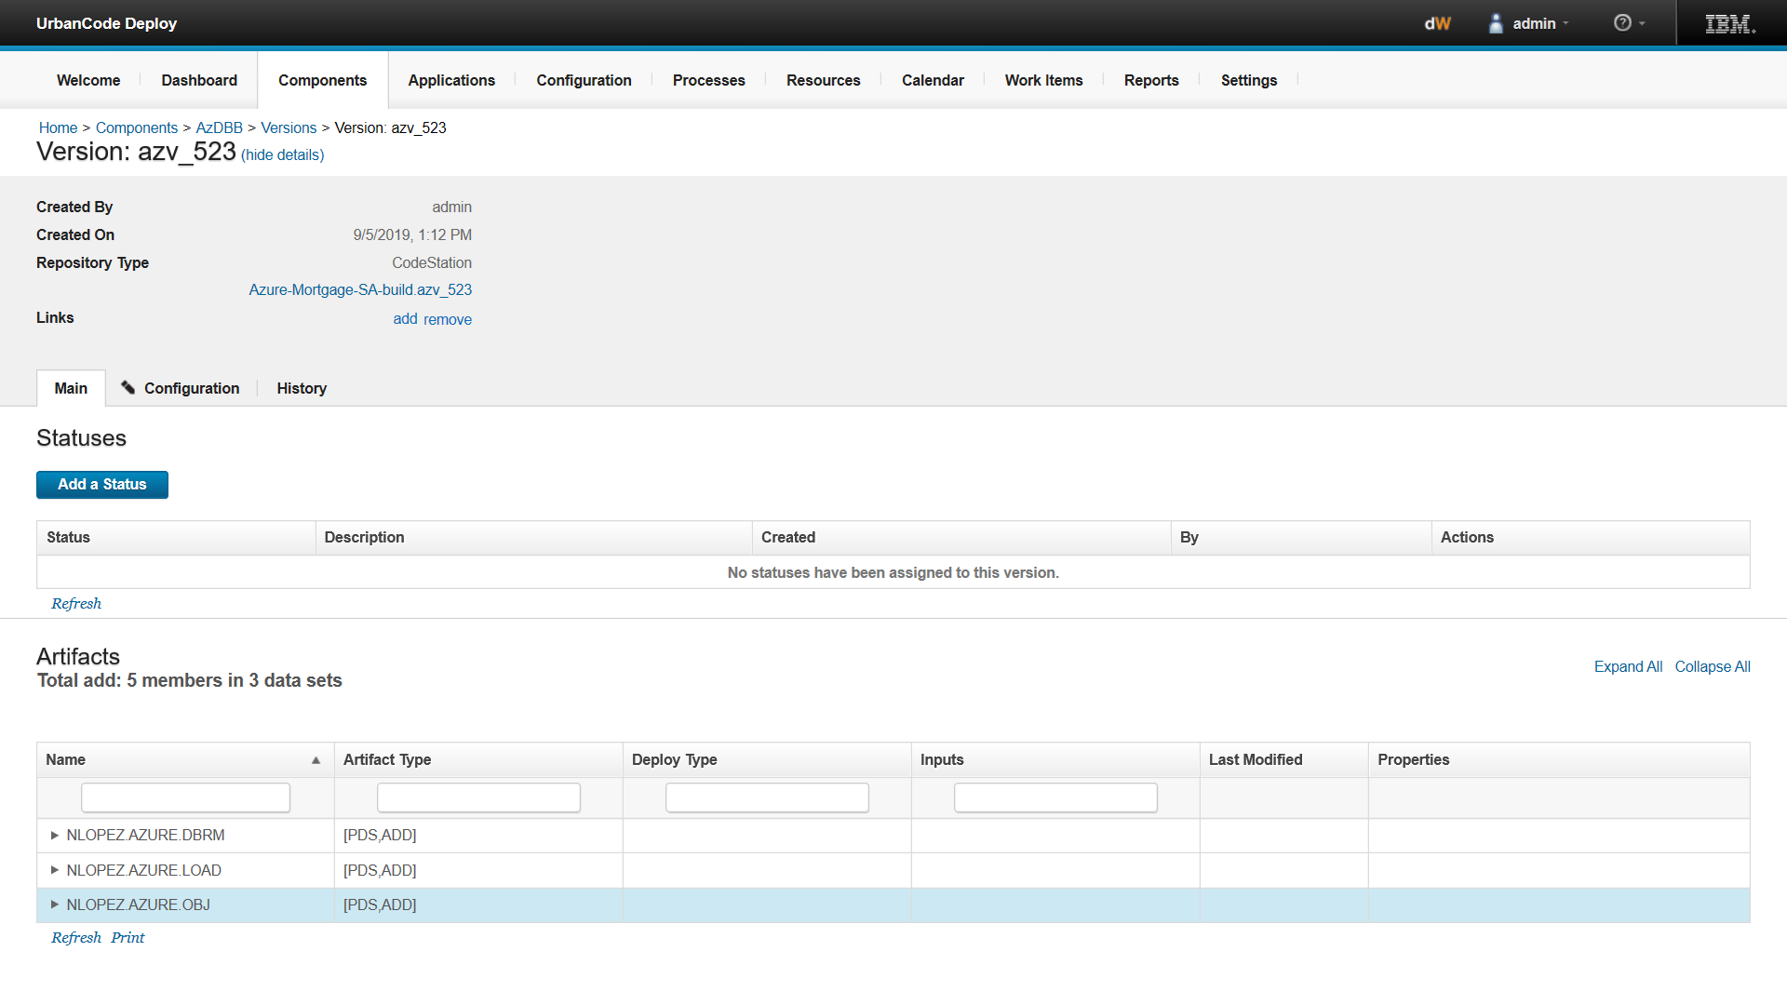
Artifact Store
view release history & details
Artifact Store
Link to trace back to DBB Build Report for this release

Slide 8
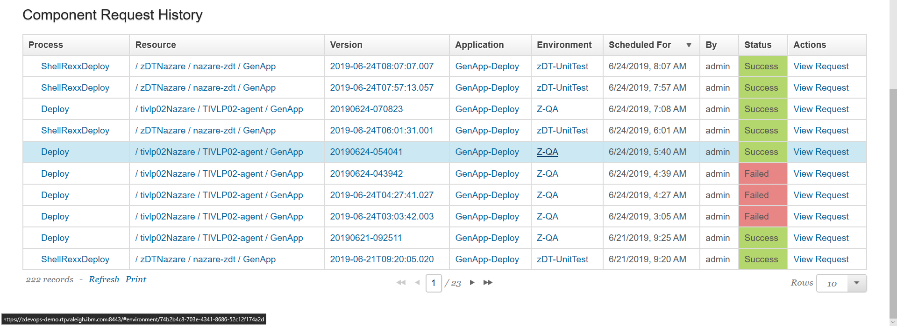
Dashboard to see where your
code has been deployed
Deployment

Slide 9
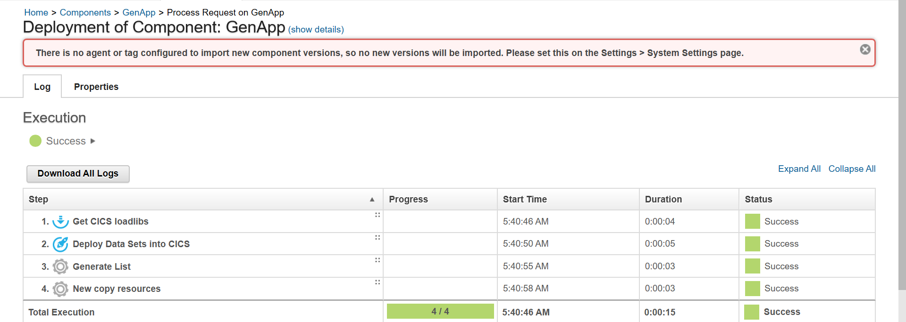
Deployment details
Deployment

Slide 10
Thank You

